Slide 1
Semantic Web Expert System Shell (SWEXSYS)
Omoju A. Thomas and David J. Russomanno
Department of Electrical and Computer Engineering
The University of Memphis
Memphis, TN USA 38152

Slide 2
The Evolution of Web Technologies
World Wide Web
HTML
Formatted for humans read via web browsers
Formatted for machine readability but with very limited semantics
XML
Semantic Web
Machine readability with very rich semantics to support:
RDF/OWL
Agents that Solve Tasks
  Intelligence Analysis
  Military Planning and Operations
  Sensor Fusion
RDF/OWL provides infrastructure to realize the vision of the Semantic Web

Slide 3
SWEXSYS Project Tasks
  Reasoning Agents
    Develop Expert System Shell
      use Semantic Web compliant sources as its knowledge base
      incorporate various reasoning engines
      apply to applications (sensor-based systems)
  Semantic Web Resources
    Develop repository of knowledge, data and services that can be reasoned with by machines
  Ontologies
    Define domain-specific shared conceptualizations

Slide 4
SWEXSYS Workflow
Accepts Semantic Web resources as inputs:
  marked-up intelligence reports
  sensor data
  images
  Web pages
  databases
Interprets the knowledge and data using several different inference strategies to develop conclusions
Provides rationale to the user for its conclusions through its explanation system

Slide 5
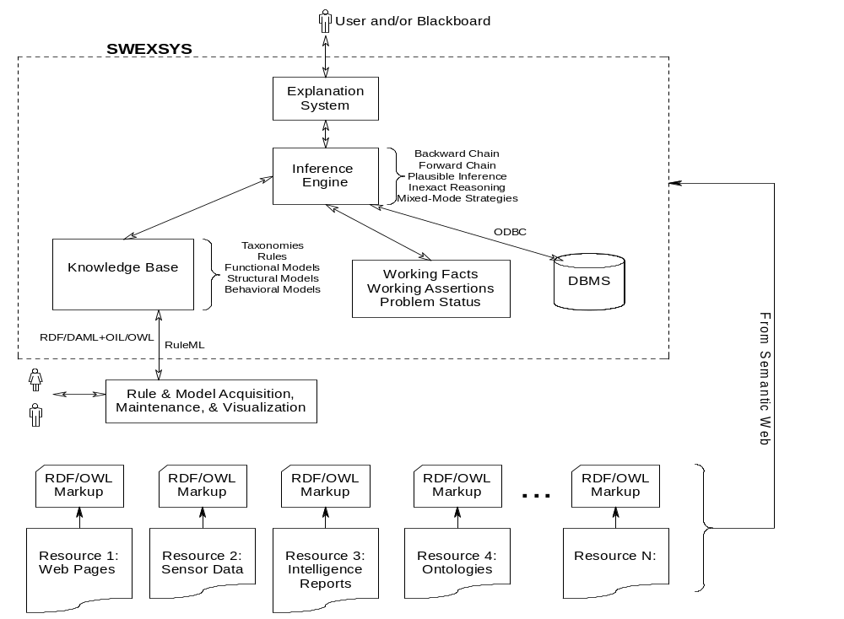

Slide 6
SWEXSYS: Knowledge Base
Supports Protégé 2000
    Plug-In too slow
    Export the knowledge bases to RDF
Supports import/export of rules expressed in RuleML
Supports a custom, rule language expressed in Prolog
Supports ontologies and electronic dictionaries in RDF
    IEEE Suggested Upper Merged Ontology (SUMO)
    WordNet

Slide 7
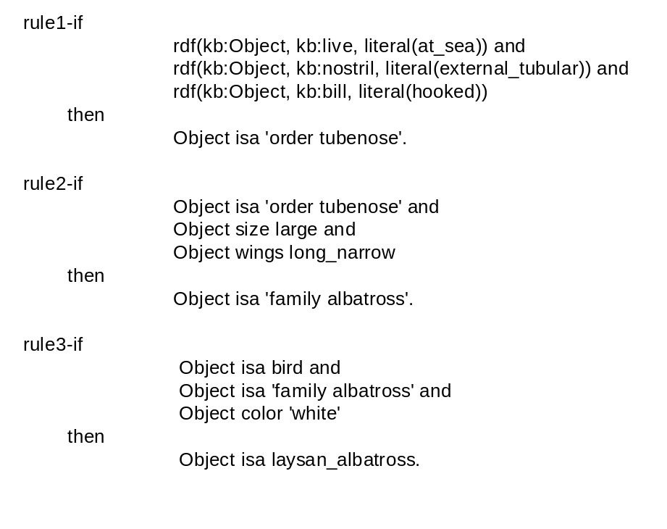
Custom Rules
First rule’s premise includes three sub goals represented as RDF triples
Triples can be thought of as a restricted view of a frame about birds with name “kb:Object”
Prefix “kb:” is a namespace alias for the fully qualified RDF resource
Each sub goal is expressed as a partially instantiated RDF triple that can be satisfied as illustrated below:
?- rdf(kb:Object, kb:live,literal(at_sea)).
Object = koko

Slide 8
SWEXSYS: Database
SWEXSYS database consists of
  Specific facts
    observed by human and told to SWEXSYS
    sensed from the environment and marked-up in RDF
    loaded from other ODBC sources
  Reified RDF statements
    asserted by SWEXSYS using one of its inference processes

Slide 9
SWEXSYS: Inference Engine
Inference strategy accommodates:
  Goal-driven reasoning using SLD resolution
  Forward-driven reasoning with conflict resolution strategies
  Inexact reasoning (e.g., certainty factors)
  Plausible reasoning strategies using extended composition of relations
  Export of conclusions as reified statements in RDF

Slide 10
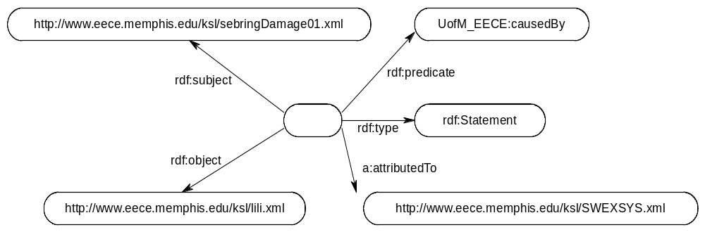
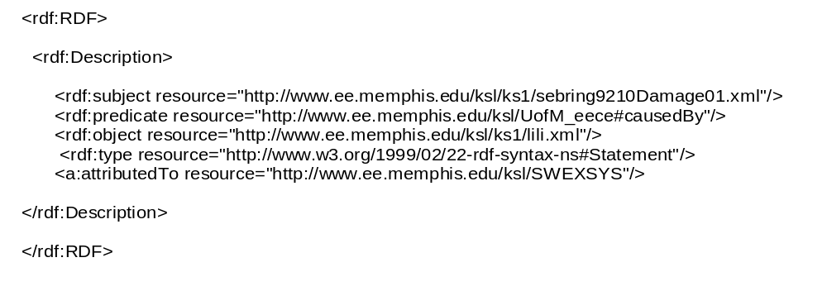
Reified SWEXSYS Inference

Slide 11
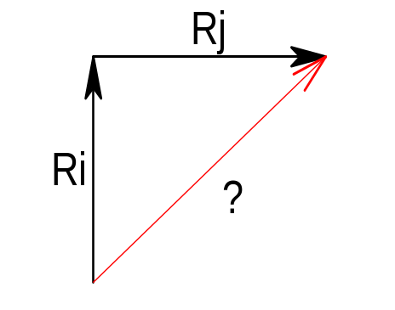
SWEXSYS: Plausible Inference
SWEXSYS implementation:
  Uses meta properties and an algebra to determine the composition of two instantiated properties
  Result:
    Knowledge/Data mine of an additional plausible instance of one of the two composed properties or a new instance of yet another property

Slide 12
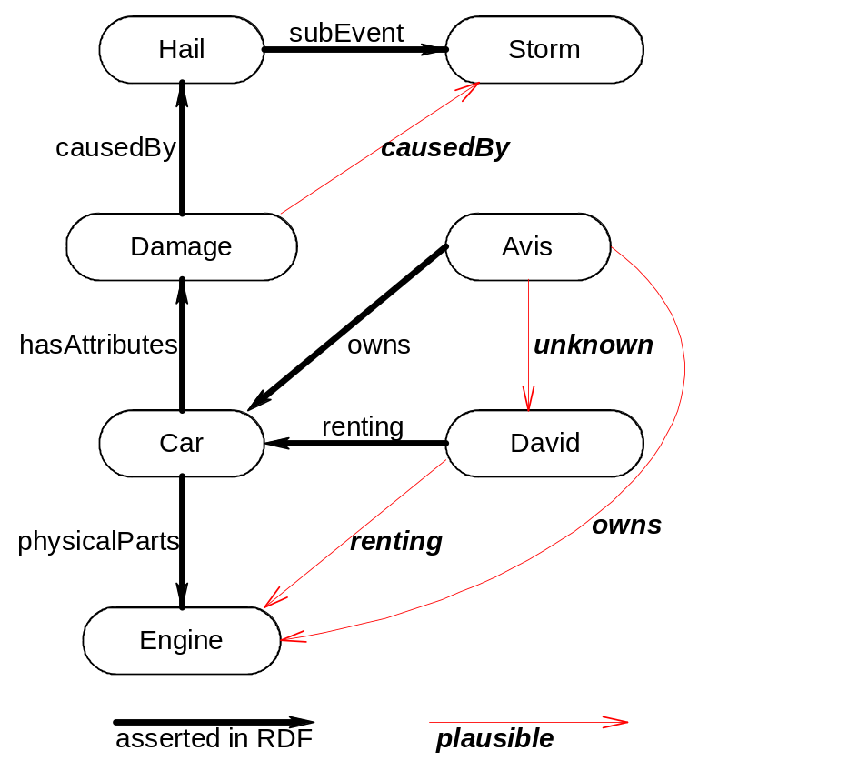
SWEXSYS: Plausible Inference
Nodes are Web Resources:
http://www.eece.memphis.edu/ksl/ks1/hail001.xml
http://www.eece.memphis.edu/ksl/ks1/sebring9210.xml
http://www.eece.memphis.edu/ksl/ks1/engine001.xml
http://www.eece.memphis.edu/ksl/ks1/sebring9210damage01.xml
http://www.eece.memphis.edu/ksl/ks1/lili.xml

Slide 13
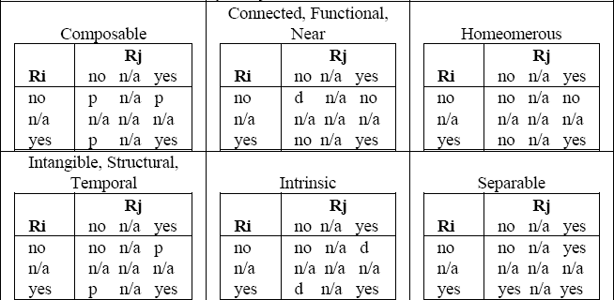
SWEXSYS: Plausible Inference
Ri  Rj ≡ V_{Ri} o V_{Rj} in which VR ε X¹⁰ and X = {yes, no, n/a}
Vrenting = [yes, no, no, no, n/a, yes, n/a, yes, n/a, n/a]
VphysicalParts= [yes, yes, yes, no, no, no, yes, yes, no, n/a]
----------------------------------------------------------------------------------------------
Vrenting o VphysicalParts = [yes, no, no, no, n/a, d, n/a, yes, n/a, n/a]

Slide 14

SWEXSYS: Explanation Facility
SWEXSYS can generate a trace of its goal satisfaction
Current work also includes adding explanation facilities for non-classical reasoning processes including plausible inference

Slide 15
SWEXSYS Limitations
Limited to approximately 40 million RDF triples in RAM
Scale-up issues will become critical
Needs domain-specific applications to demonstrate utility

Slide 16
SWEXSYS Implementation
Uses Prolog infrastructure developed by The University of Amsterdam (SWI-PROLOG)
    Good Performance
    Open source
    Extensive XML/RDF libraries
    Good level of support for evolving Semantic Web standards (RDF, OWL)

Slide 17
Future Plans
Improve SWEXSYS Infrastructure
  support OWL and SWRL (Semantic Web Rule Language)
  improve persistent Data Management
Develop Applications
  develop embedded system for monitoring of fused sensor data for situation assessment.
  develop parts list configuration assistant for building and maintaining sensor-based sub systems from Semantic Web catalogs.

